Slide 1
Test_Phylo
Kyle Johnson

Slide 2
Tables SARs

Slide 3
Inbitial Thoughts Slide
Originally did by the following:
Parasites, Photosynthetic symbiotes, Ciliates
Found some out-lier organisms which are unicellular
In Stramenopiles, fairly uniform distribution of TOR Components
Rhizaria information is unreliable at current moment
Alveolata contained wide majority of parastic organisms

Slide 4
Continued Work
Expanded research parameters to include the following:
For Archaeplastida: Streptophyta, chlorophyta, rhodophyta
For Excavata: Discoba and Metamonada
Currently looking for more information about Rhizaria
Beginning SRA work to rule out/in some outlier species in all supergroups
Expanding the phylogenetic trees for the protein components

Slide 5
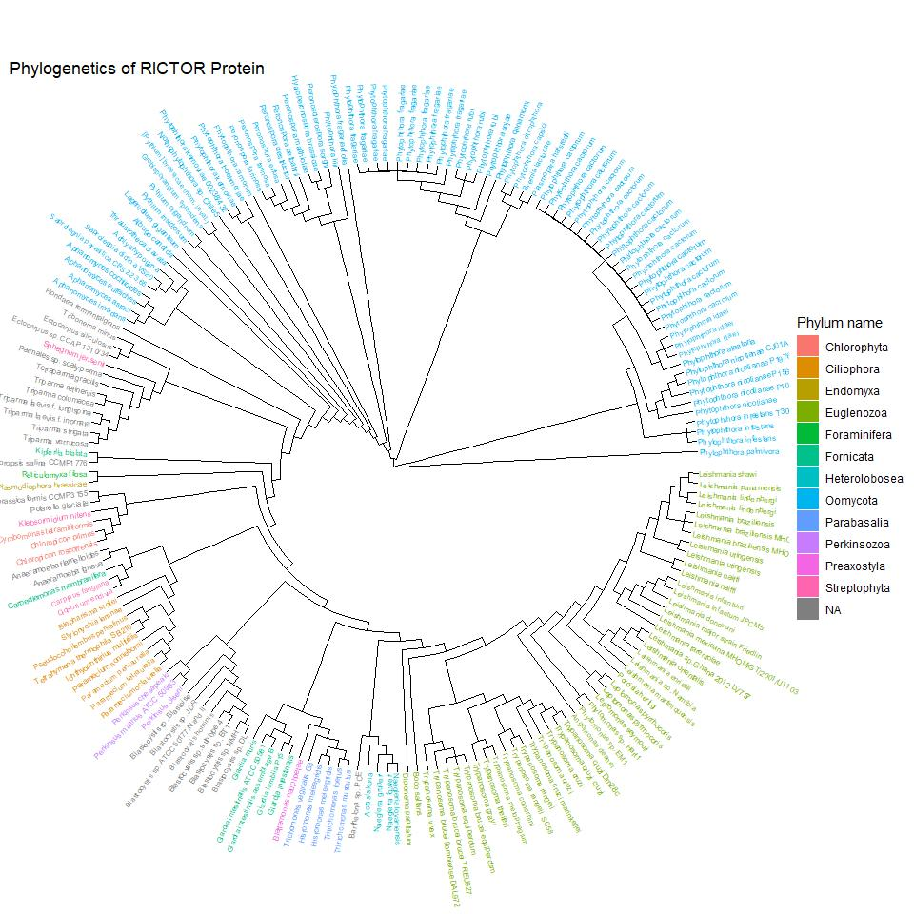
Combined Rictor Tree

Slide 6
Slide

Slide 7
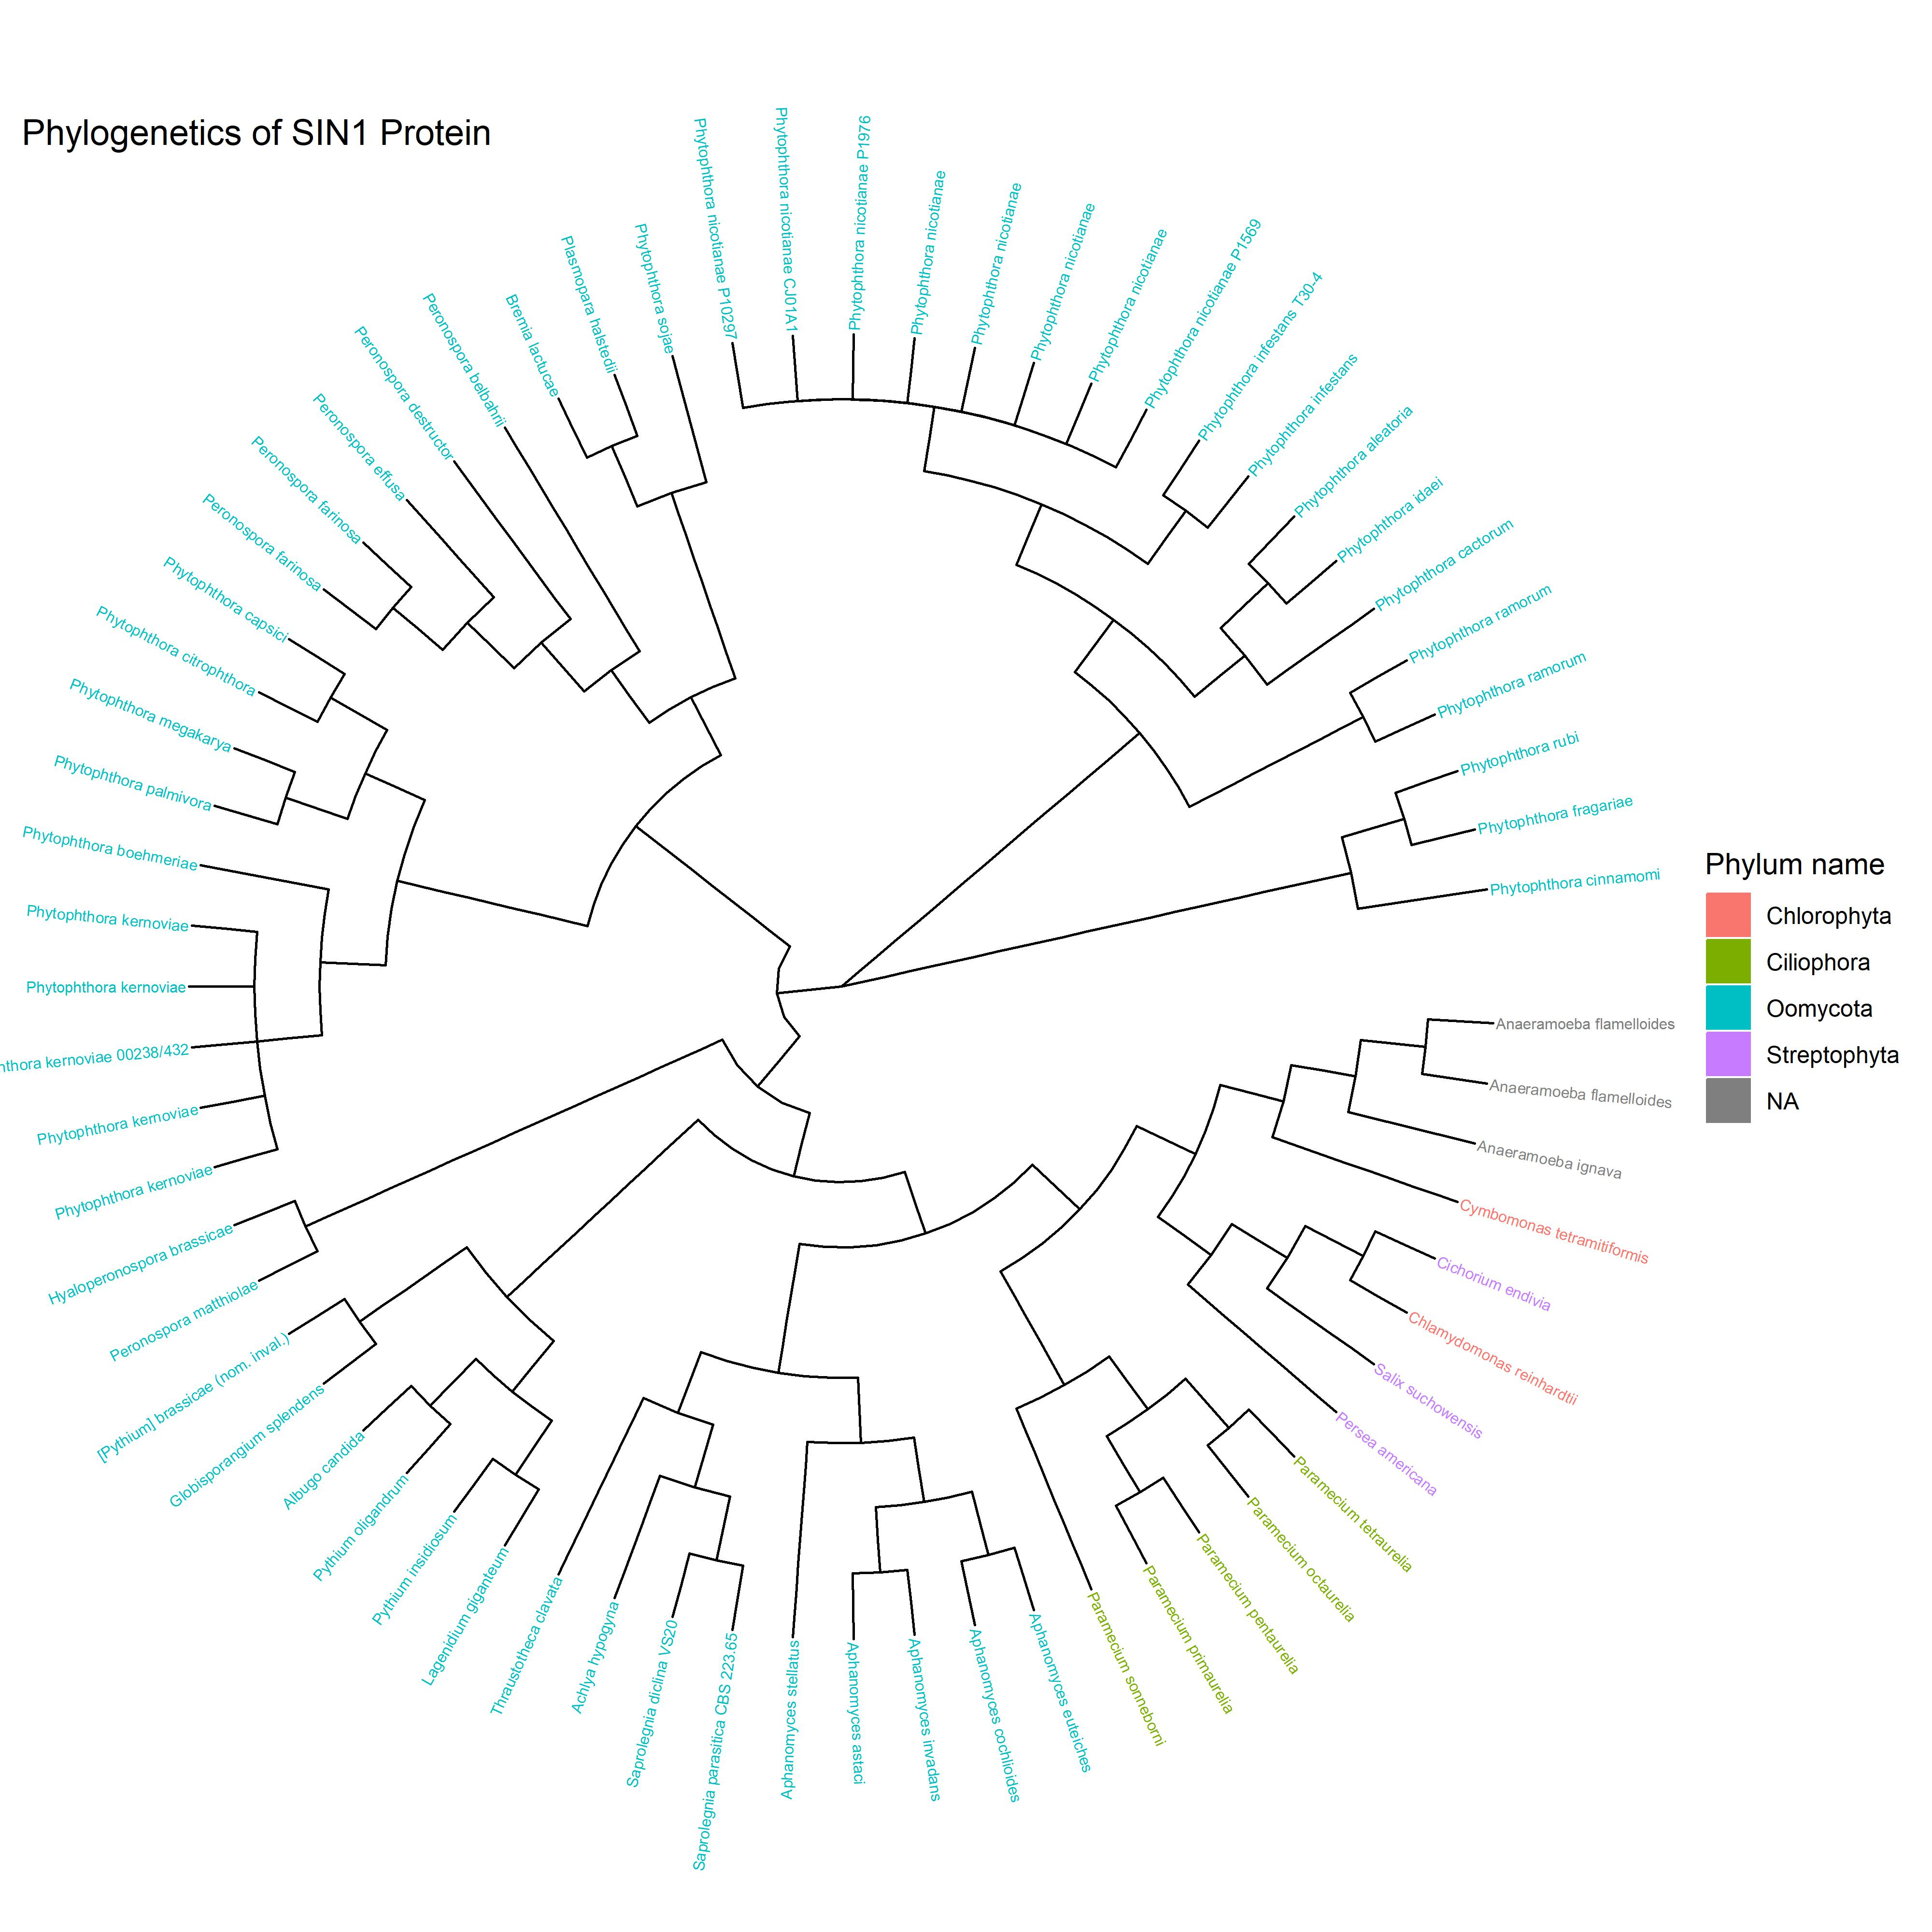
Combined SIN1 Tree

Slide 8
Slide

Slide 9
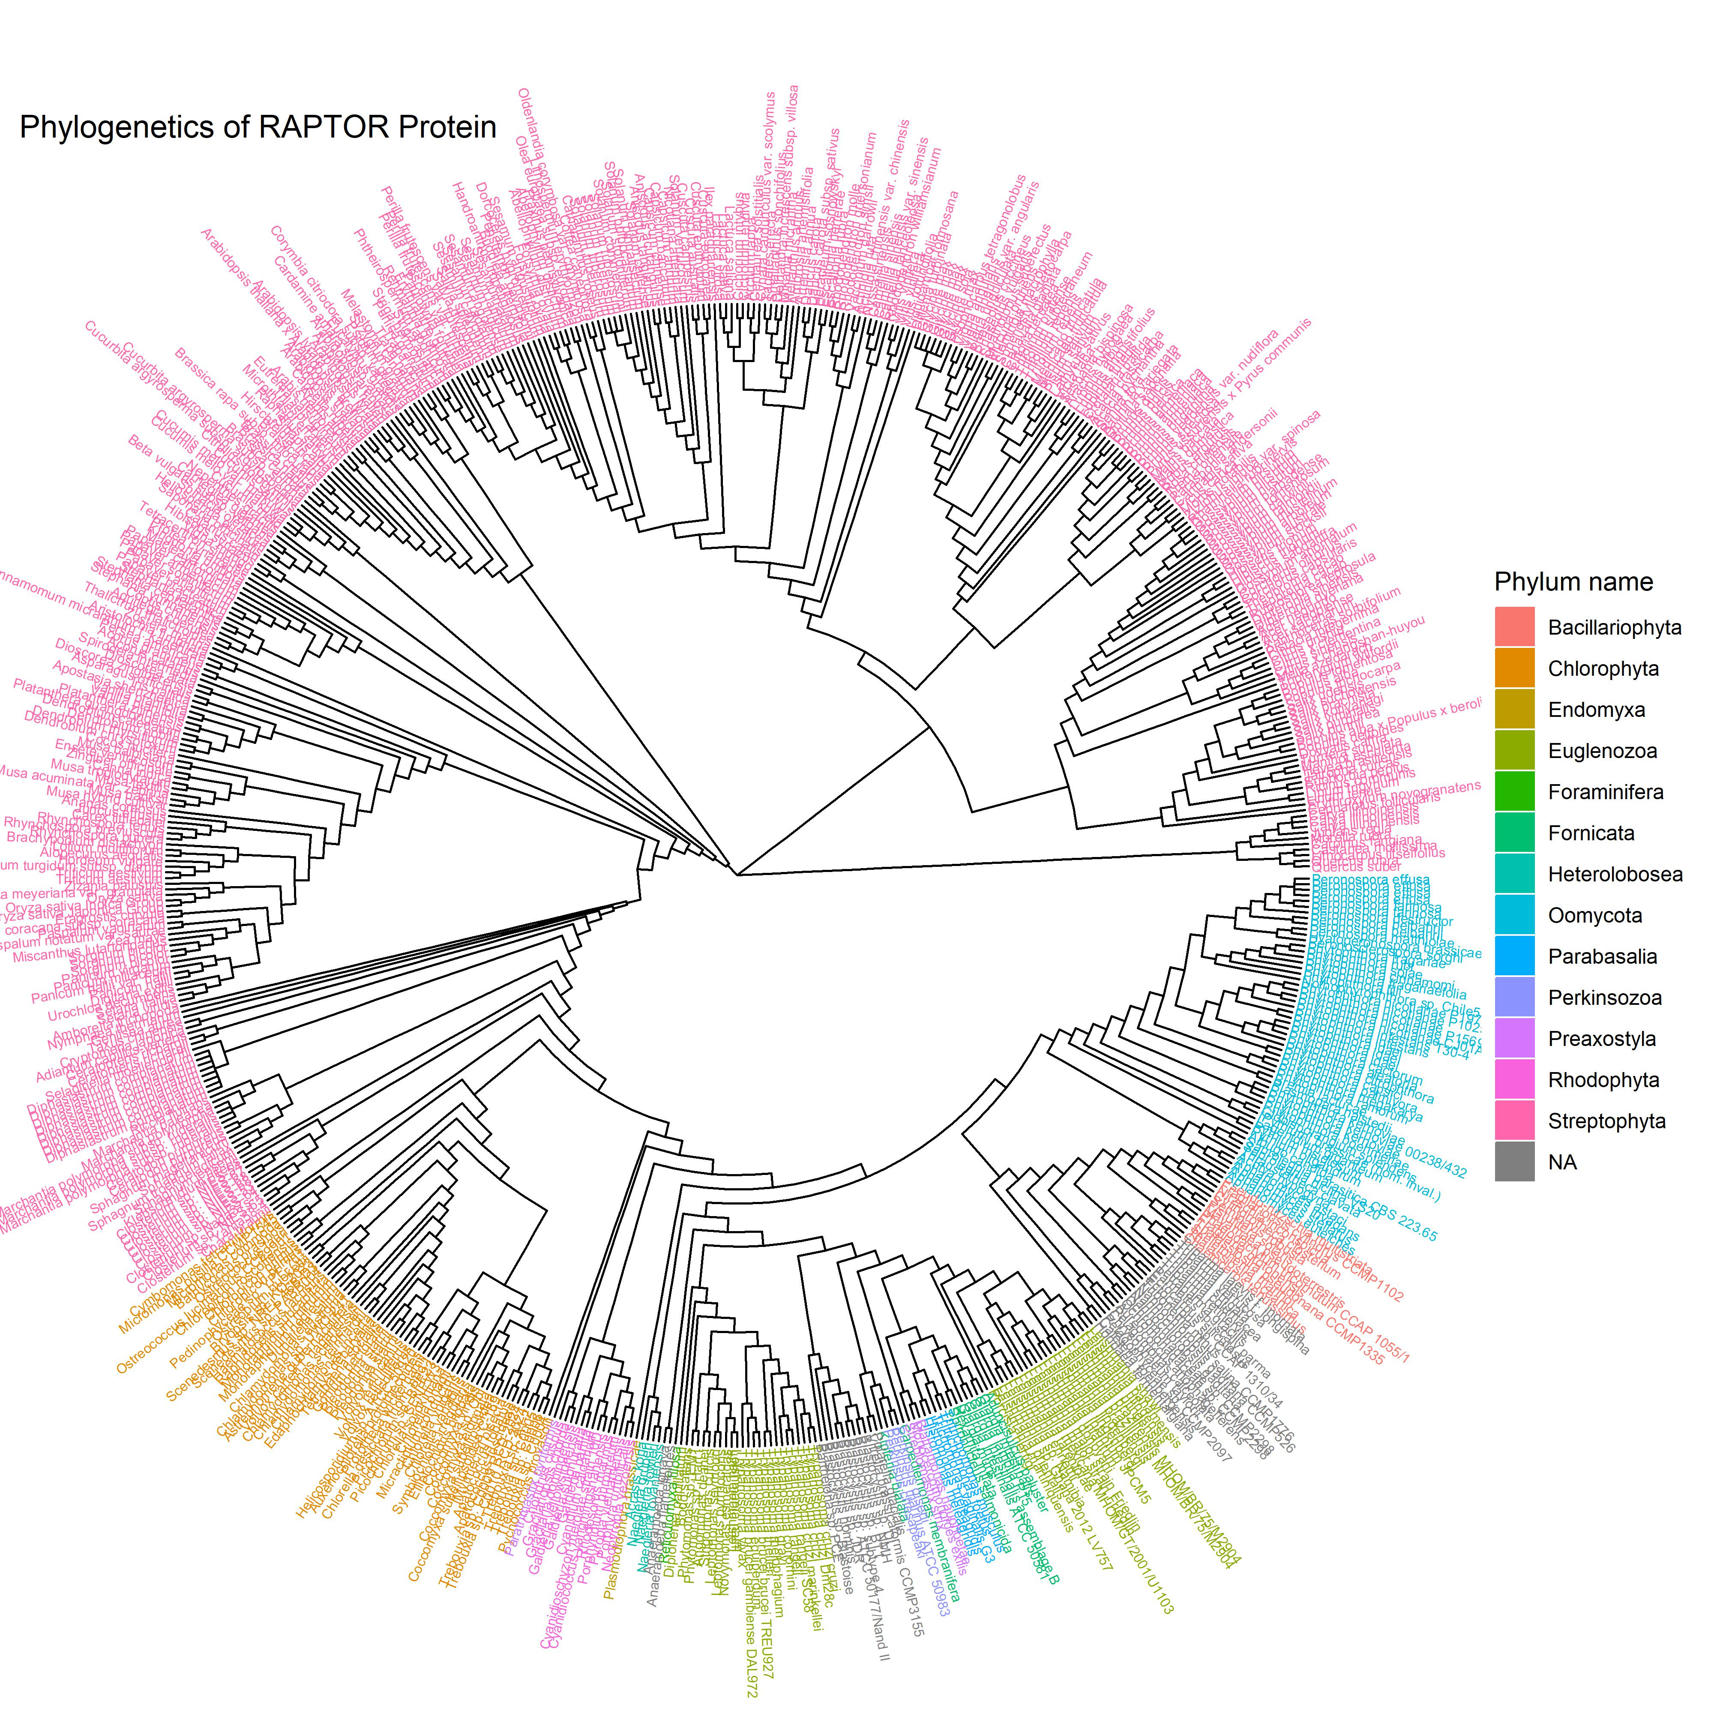
Combined RAPTOR Tree

Slide 10
Slide

Slide 11
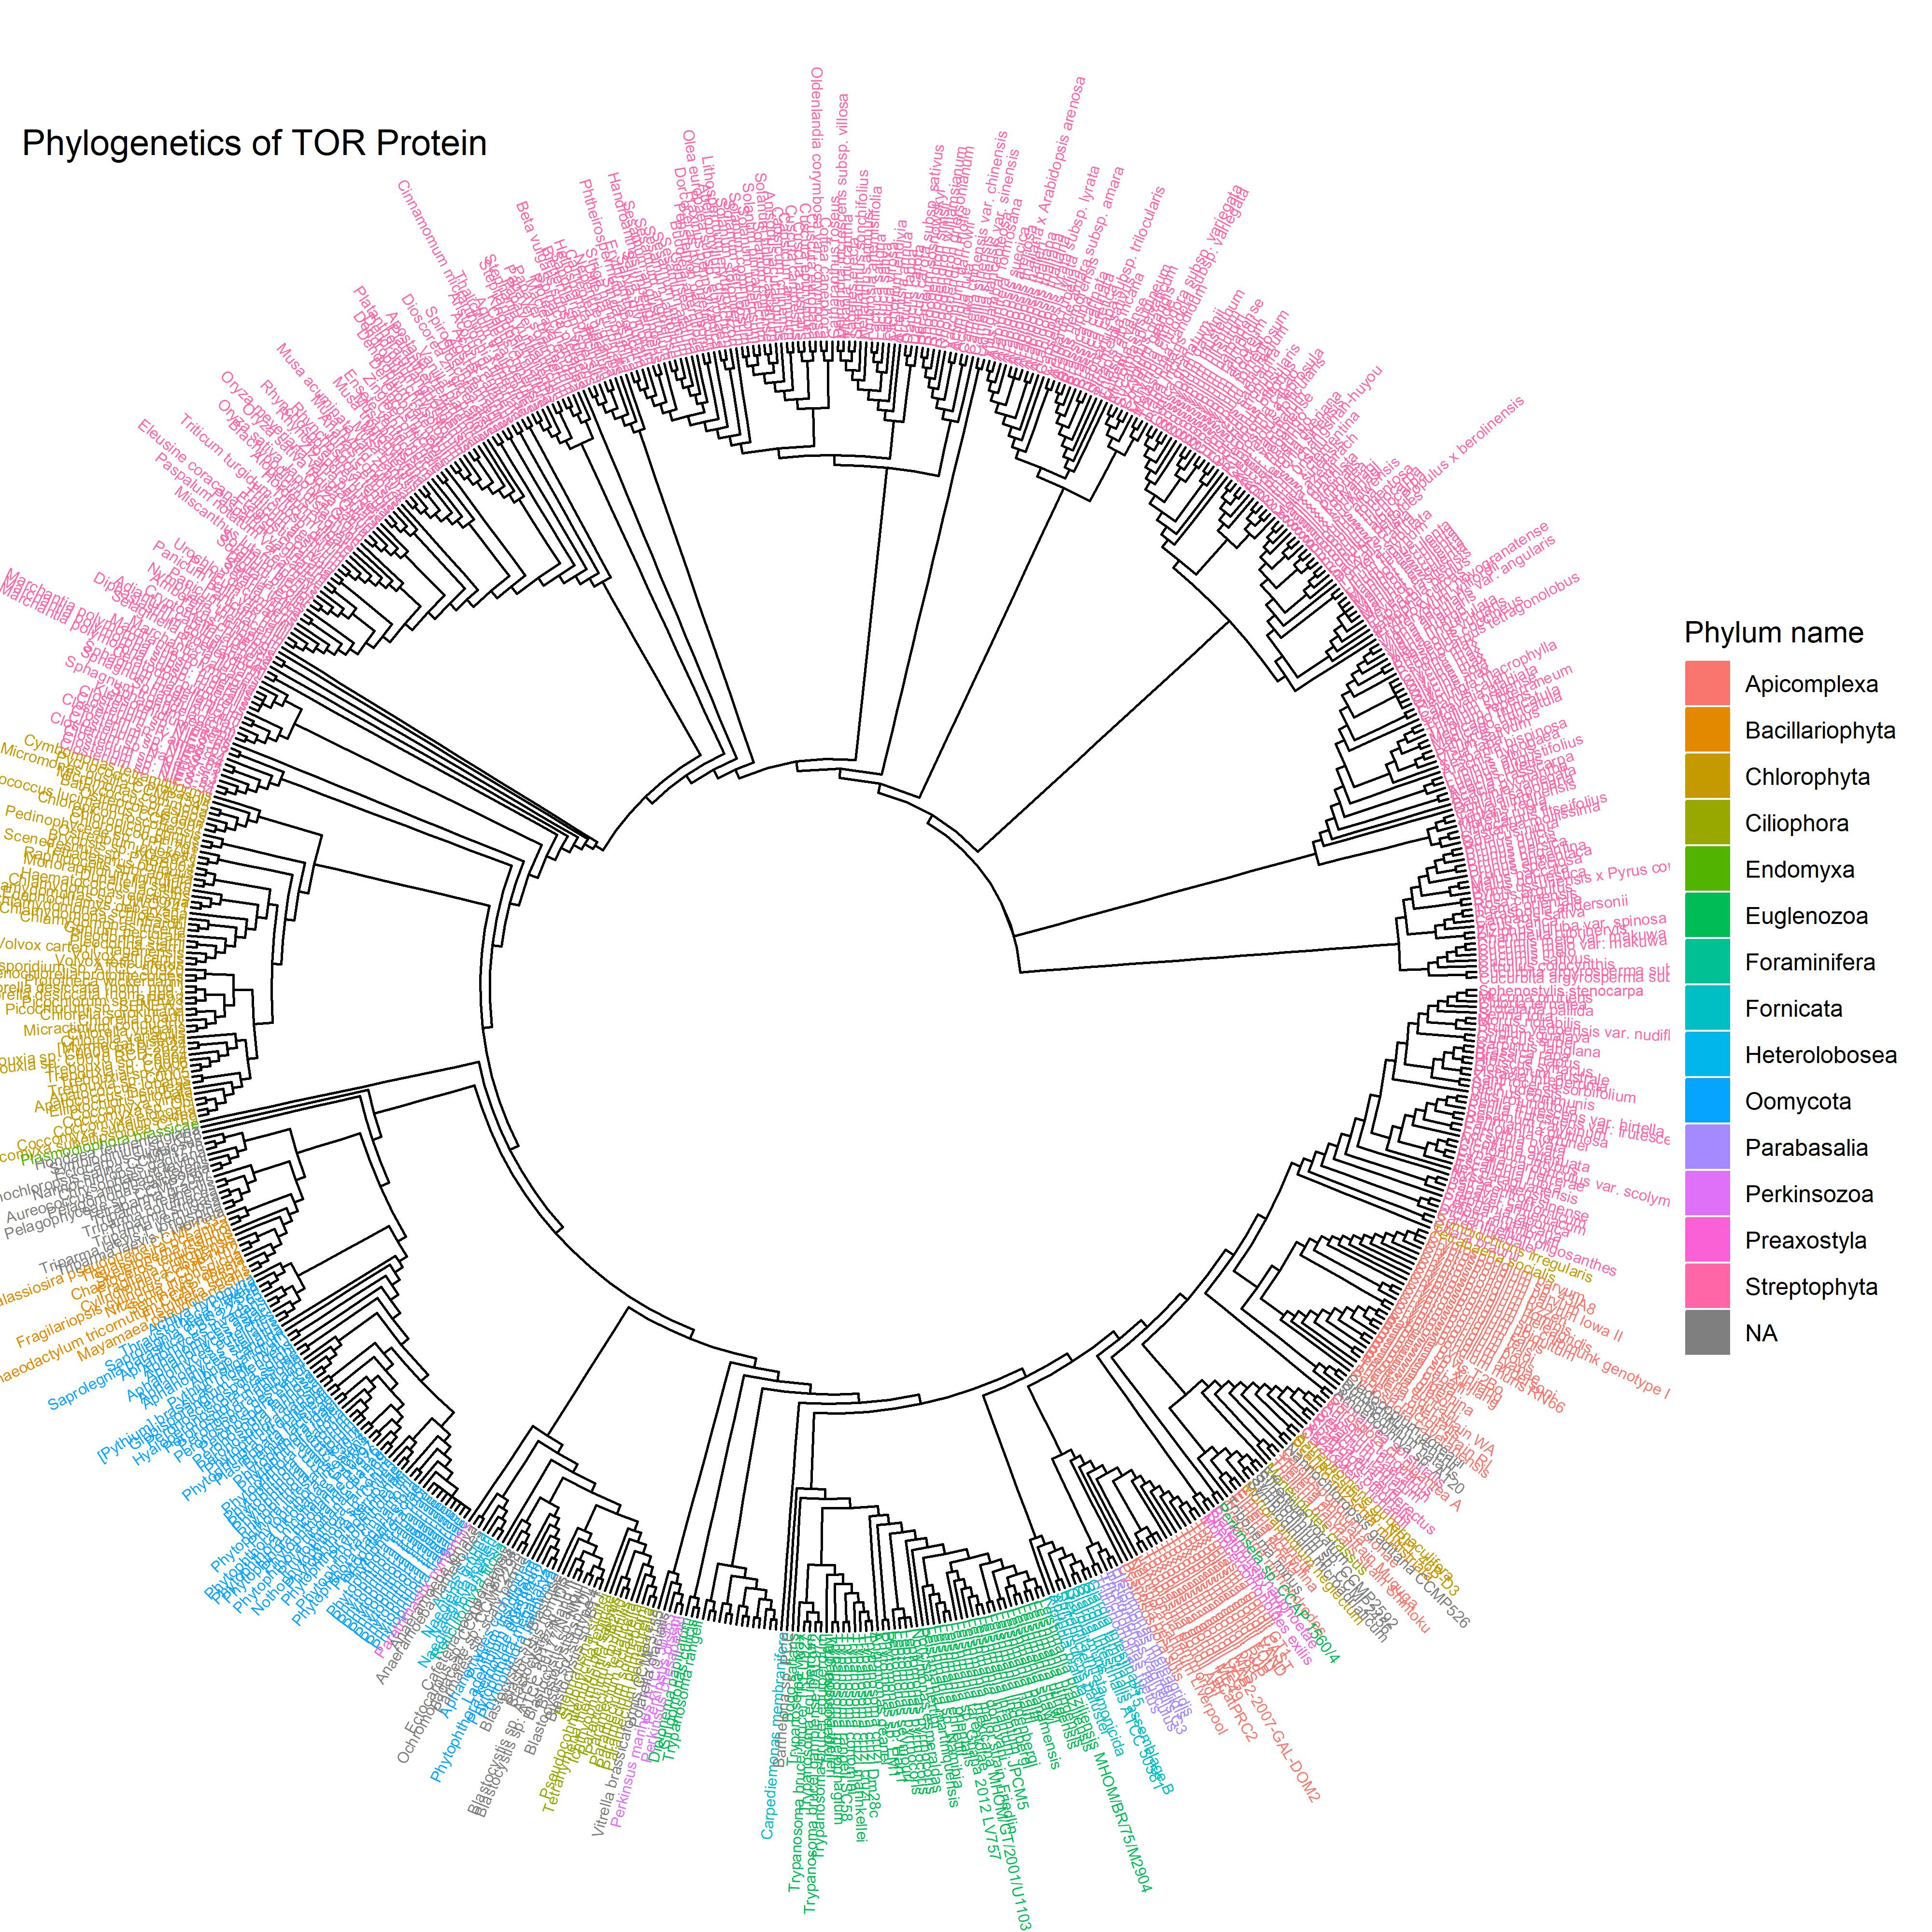
Combined TOR Tree

Slide 12
Slide

Slide 13
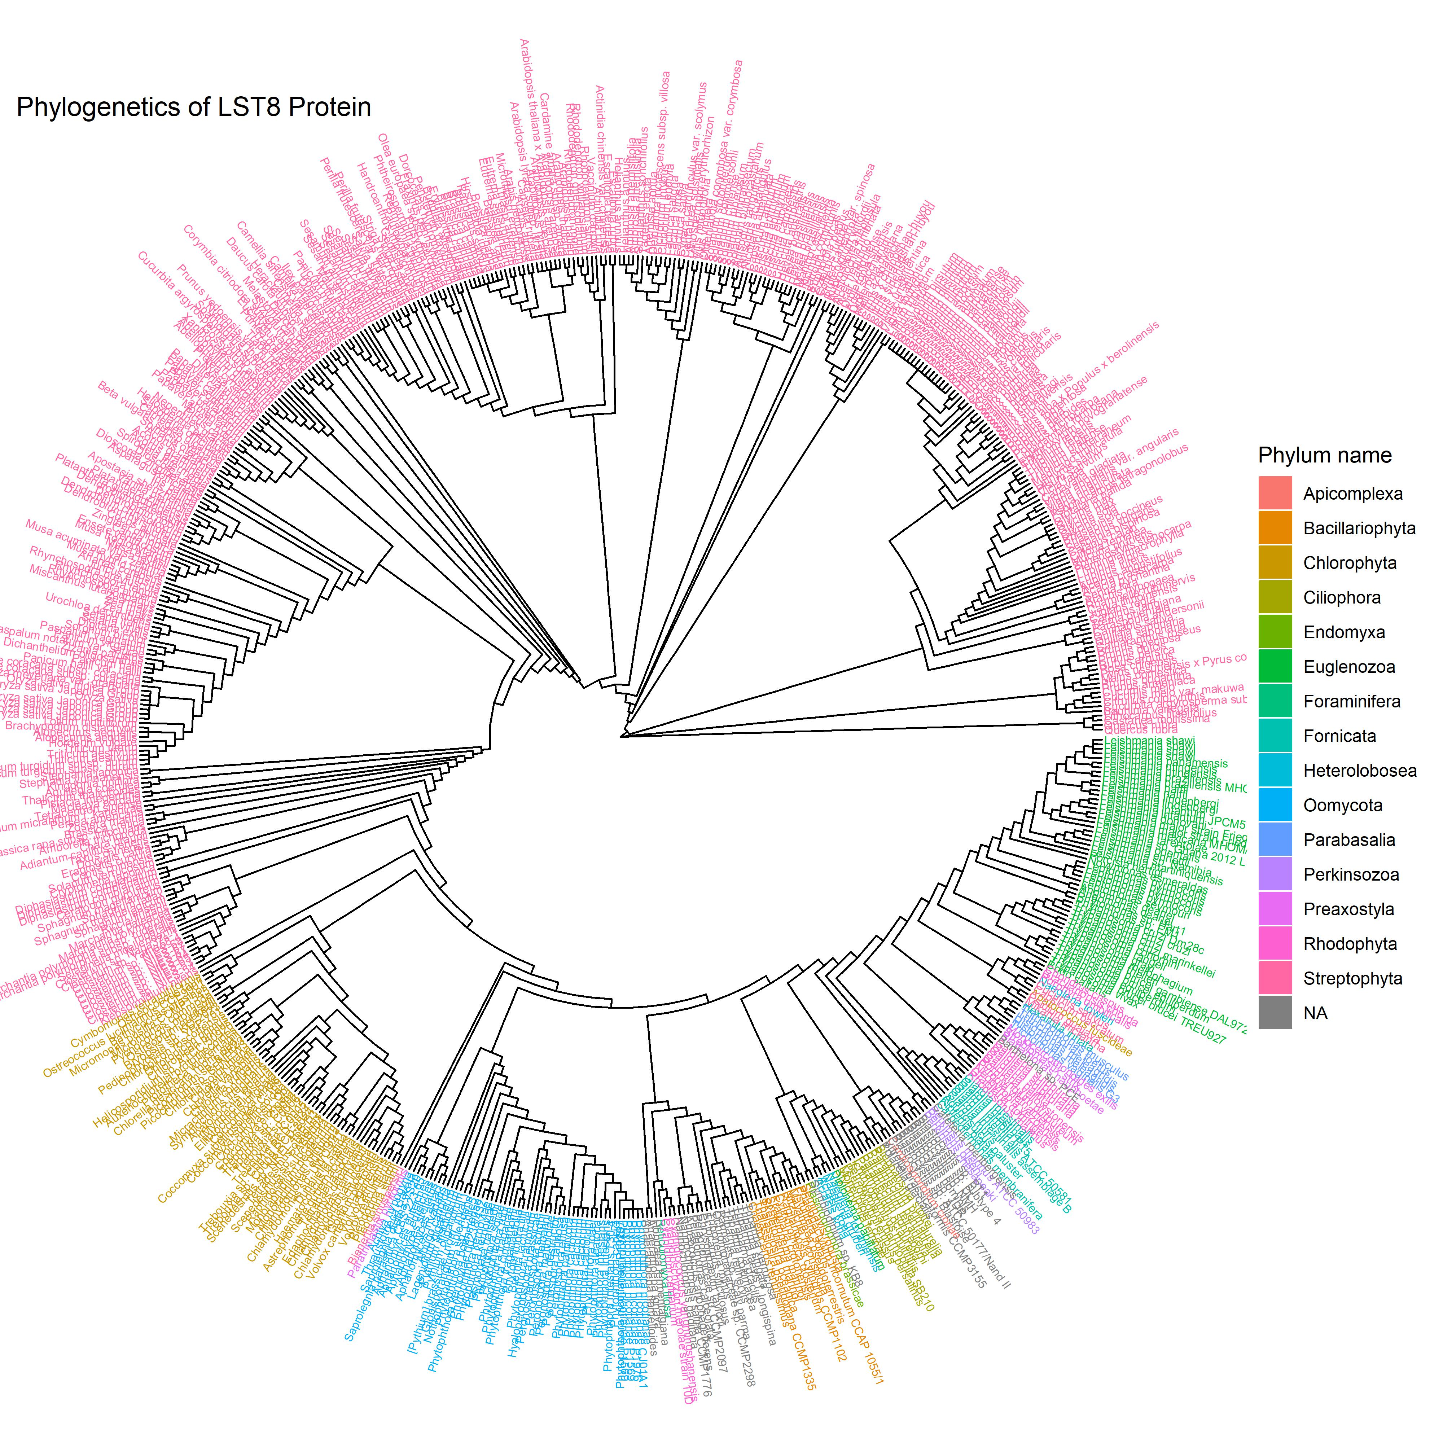
Combined LST8 Tree

